Slide 1
MASKING DECISION
SEP or MTObjects?
Evidence from four-fold toy-object optimisation and 182-galaxy production runs
Recommendation: use MTObjects first, with SEP as a gated diagnostic.
Decision briefing | 17 August 2026
Notes:
[Sources]
Project SEP and MTObjects optimisation outputs; comparison report dated 17 August 2026.

Slide 2
The evidence supports MTObjects-led gated processing
02
PRIMARY METHOD
Operating rule
MTObjects recovers more toys.
Use MTObjects as the default mask
Use science-image SEP as an independent check
Review algorithm-only components
Quarantine masks above 15% or with profile damage
It also has the safer upper masking tail.
One unattended method: MTObjects
MSc Research | Toy-object foreground masking | 17 August 2026
Notes:
[Sources]
Project comparison report, sections 4â€“5.

Slide 3
The comparison separates recovery from production risk
03
FOLD 1
FOLD 2
FOLD 3
FOLD 4
30 train
30 train
30 train
30 train
10 held out
10 held out
10 held out
10 held out
40 common-set check
40 common-set check
40 common-set check
40 common-set check
Then: selected model to all 182 galaxies, producing aligned eight-panel PNG reports
Caveat: the SEP and MTObjects runs used different toy-injection seeds and different scalar objectives. Compare shared recovery and masking metrics, not raw objective scores.
MSc Research | Toy-object foreground masking | 17 August 2026
Notes:
[Sources]
SEP science-image CV run 20260817_161404; MTObjects recovery run 20260816_063455.

Slide 4
MTObjects recovered more contaminants across held-out folds
04
Four-fold held-out mean
Toy recall | SEP
40.4%
+7.1 pp
Toy recall | MTO
47.6%
MTO toy-recall advantage
Toy detection | SEP
40.8%
+9.6 pp
Toy detection | MTO
50.4%
MTO toy-detection advantage
Masked area | SEP
4.9%
Masked area | MTO
7.5%
MSc Research | Toy-object foreground masking | 17 August 2026
Notes:
[Sources]
Held-out means calculated from four-fold SEP and MTObjects result summaries.

Slide 5
Typical masking is similar, but SEP has the heavier tail
05
Masked image area across 182 galaxies
Mean | SEP
8.8%
10
Mean | MTO
8.9%
SEP galaxies above 15%
95th percentile | SEP
15.2%
95th percentile | MTO
12.7%
1
MTObjects galaxy above 15%
Maximum | SEP
33.3%
Maximum | MTO
19.0%
MSc Research | Toy-object foreground masking | 17 August 2026
Notes:
[Sources]
SEP and MTObjects 182-galaxy apply-summary CSV files.

Slide 6
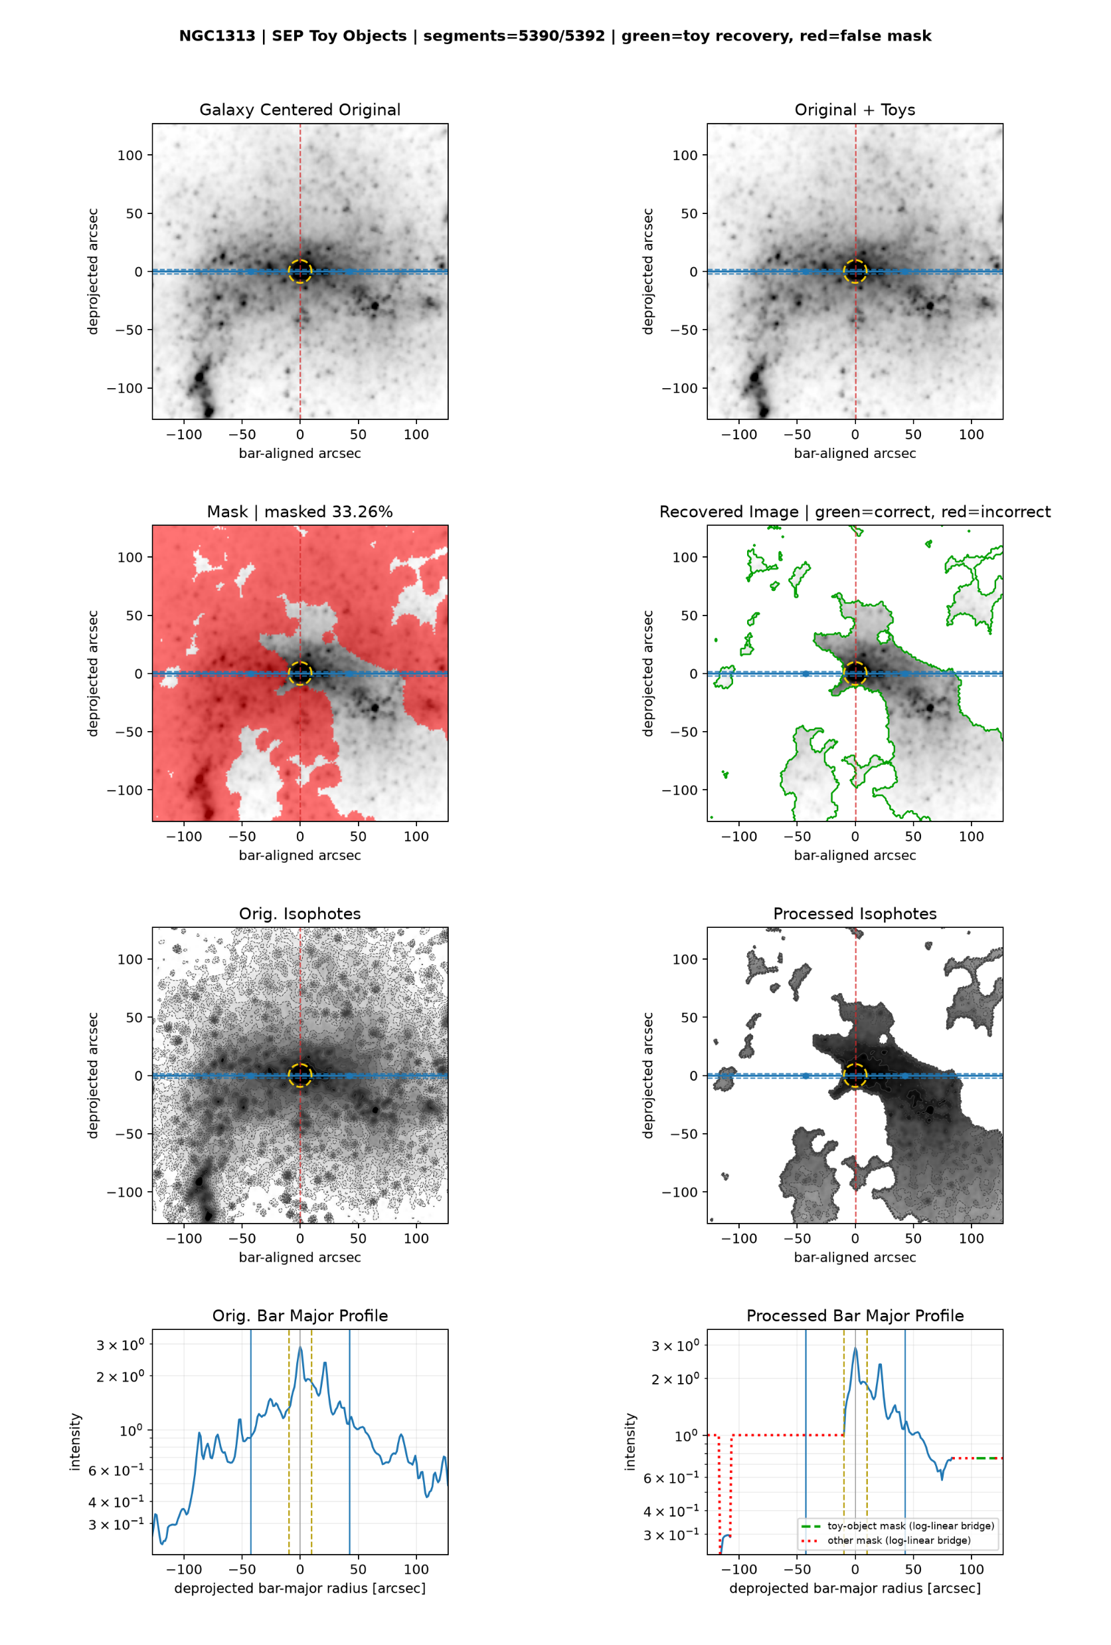
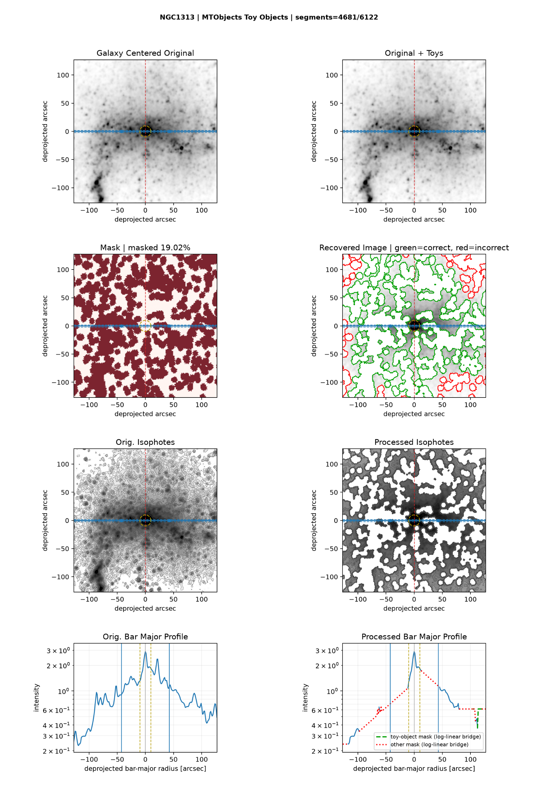
NGC1313 illustrates why recovery needs a safety gate
06
SEP | 33.3% masked
MTObjects | 19.0% masked
Use the mask, recovered-image outlines, isophotes and bar-major profiles together, not masked fraction alone.
MSc Research | Toy-object foreground masking | 17 August 2026
Notes:
[Sources]
User-generated PNG reports: D:\Dropbox\Public Documents\UCLAN\MSc Research\Remove foreground objects\SEP all galaxy batch\sep_toy_cv_20260817_161404\NGC1313_sep_thr2.0_area12_deb0.0010_dil4.png ; D:\Dropbox\Public Documents\UCLAN\MSc Research\Remove foreground objects\mtobjects all galaxy batch\mtobjects_toy_recovery_20260816_063455_eight_panel_aligned\NGC1313_mtobjects_optimised_report.png

Slide 7
Choose the operating mode before choosing the algorithm
07
UNATTENDED SCIENTIFIC BATCH
SECONDARY VALIDATION
Use MTObjects
Use science-image SEP
Higher held-out toy recovery
Only one result above the 15% review gate
Safer default for preserving galaxy structure
Independent component comparison
Review every mask above 15%
Treat disagreement as a review signal
Best overall: MTObjects first; use SEP agreement as supporting evidence.
MSc Research | Toy-object foreground masking | 17 August 2026
Notes:
[Sources]
Project comparison report, decision and operating recommendation.

Slide 8
Optimise recovery and scientific safety as separate goals
08
Hard constraints
Tail-risk loss
Reject >15% masks, low detection, or profile-damage failures.
Penalise the worst 10% of galaxies, not only the mean.
Component metrics
Profile preservation
Reward per-toy recovery; penalise false components and area separately.
Add isophote, centre-gradient and bar-major-profile distortion.
Repeated seeds
Pareto selection
Optimise median recovery plus lower-tail performance over several injections.
Keep recovery, false masking and profile damage as visible objectives.
MSc Research | Toy-object foreground masking | 17 August 2026
Notes:
[Sources]
Recommendations derived from observed cross-validation and production-tail behaviour.

Slide 9
Build a robust masking pipeline in six steps
09
1
Review the 10 SEP reports above 15%
2
Save labelled components from both algorithms
3
Implement agreement and disagreement-review rules
4
Add masked-area and profile-damage release gates
5
Re-optimise with repeated seeds and tail-risk loss
6
Benchmark Photutils as an independent third method
Decision
Approve gated ensemble development; use MTObjects until the gates are validated.
MSc Research | Toy-object foreground masking | 17 August 2026
Notes:
[Sources]
Photutils SourceFinder: https://photutils.readthedocs.io/en/stable/api/photutils.segmentation.SourceFinder.html

